Slide 1
Big Data Computing

Slide 2
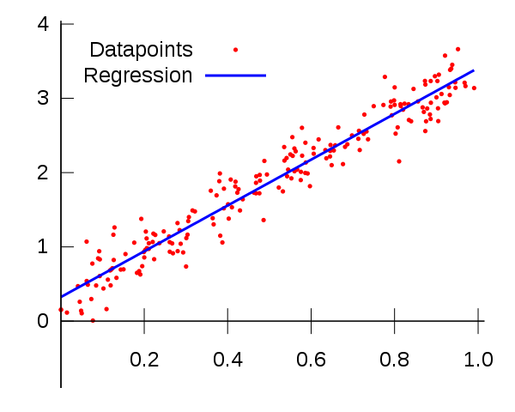
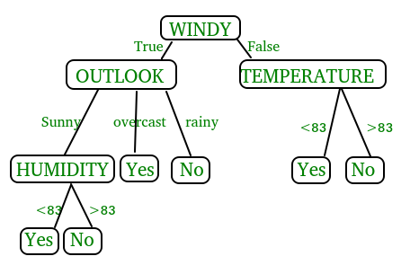
Machine Learning
Decision tree
Non- parametric classification
Divided data set into different categories
Used to predict class of target variables
Linear Regression
Parametric test
Predict dependent variable value based on a given independent variable.
Notes:
Decision trees, which can be used for the purposes of classifications and predictions, are a tool to support decision making (Lee et al., 2007). As a decision tree can accurately classify data and make effective predictions,

Slide 3
Decision Tree
Classify number of Views into classes
Encode the category into number using encoder
Split the data into train and test
Run the test
Label encoder from sklearn
70% train
30% test
<100 000 Views | Very low
100 001 <= Views < 1000 000 | Low
1 000 001 <= Views < 10 000 000 | High
10 000 001 <= Views | Very high

Slide 4
Comparing the results among different country
Country | Accuracy | Total Number of Rows
All | 0.4826 | 322491
USA | 0.5037 | 40949
Japan | 0.6235 | 20523

Slide 5
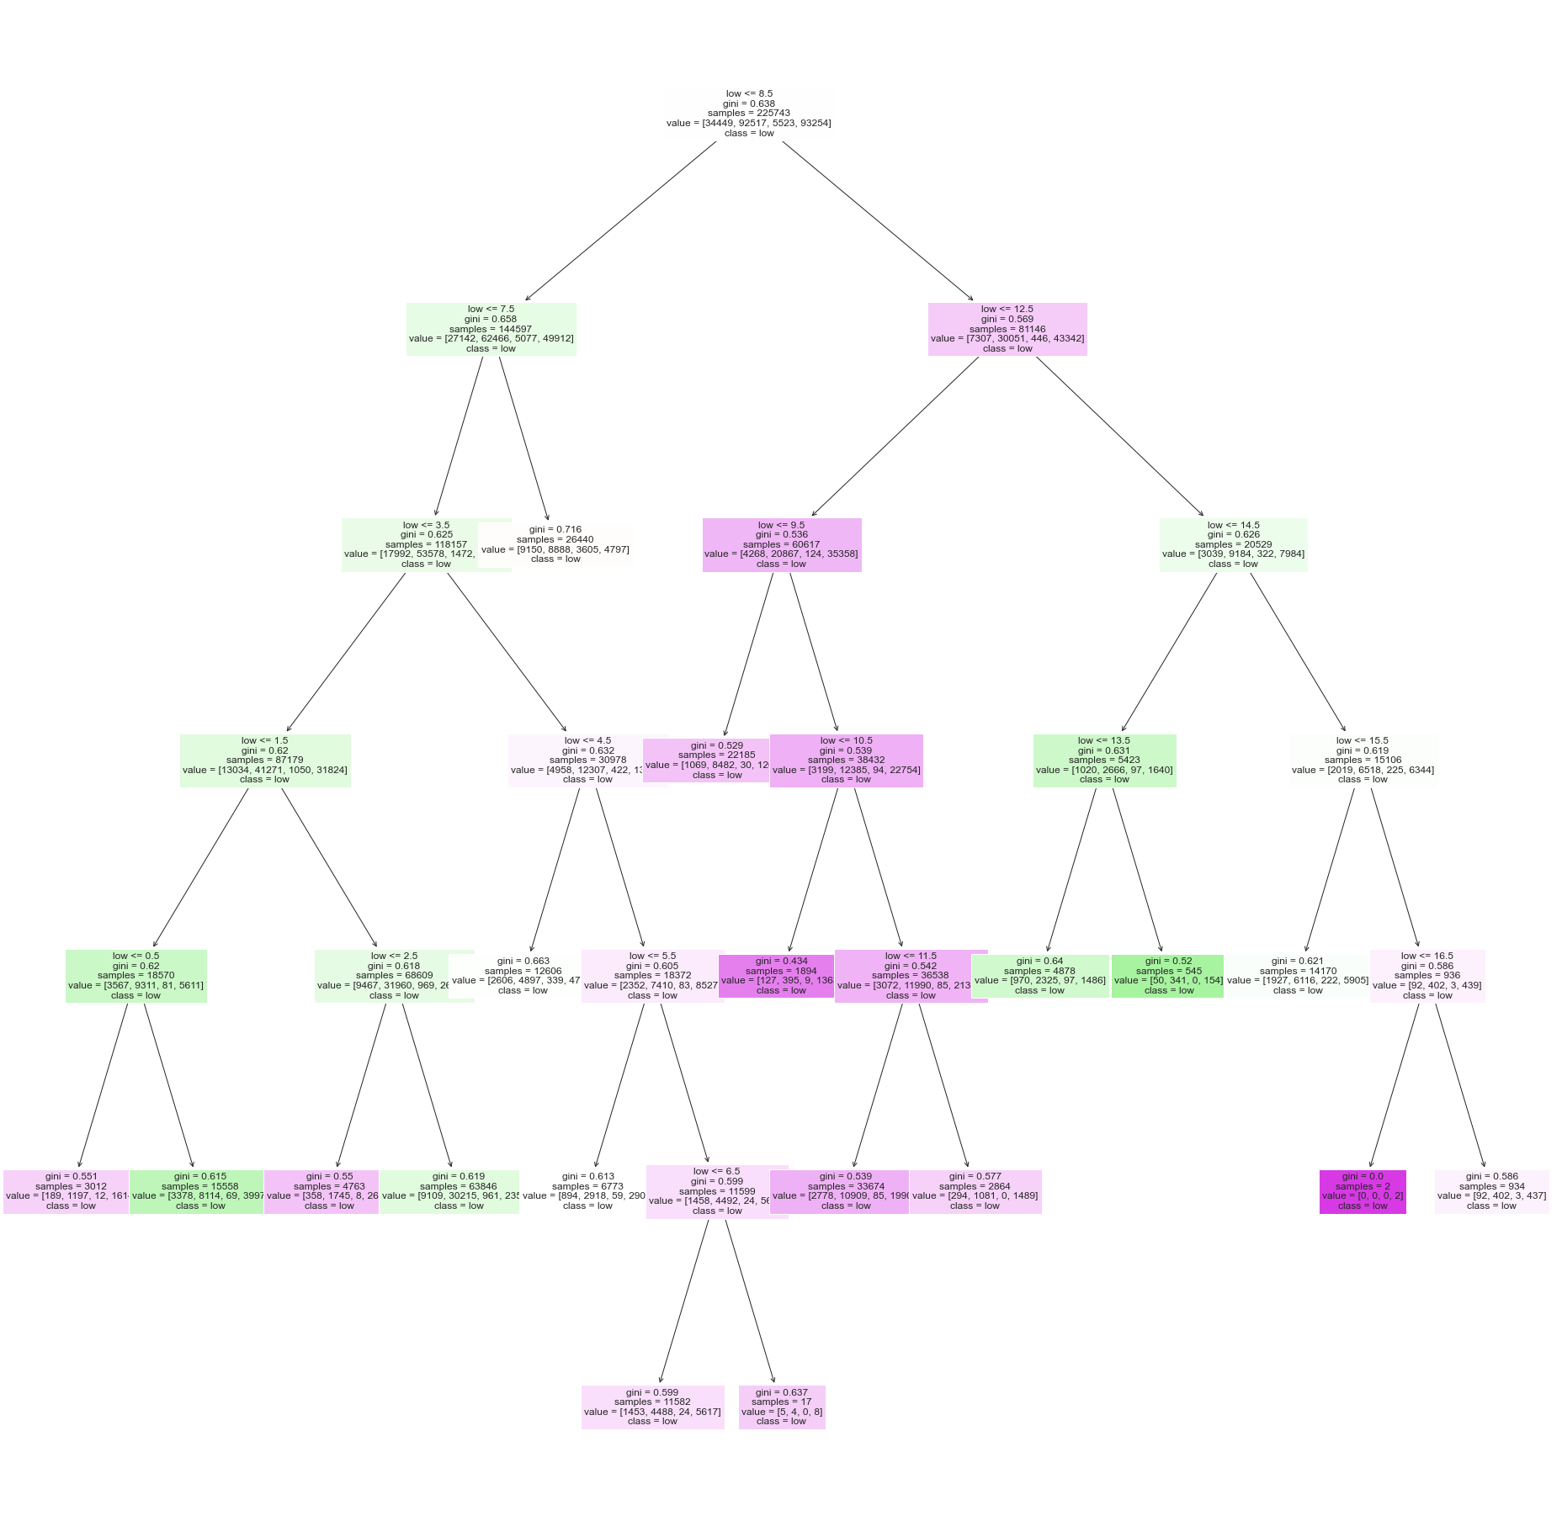
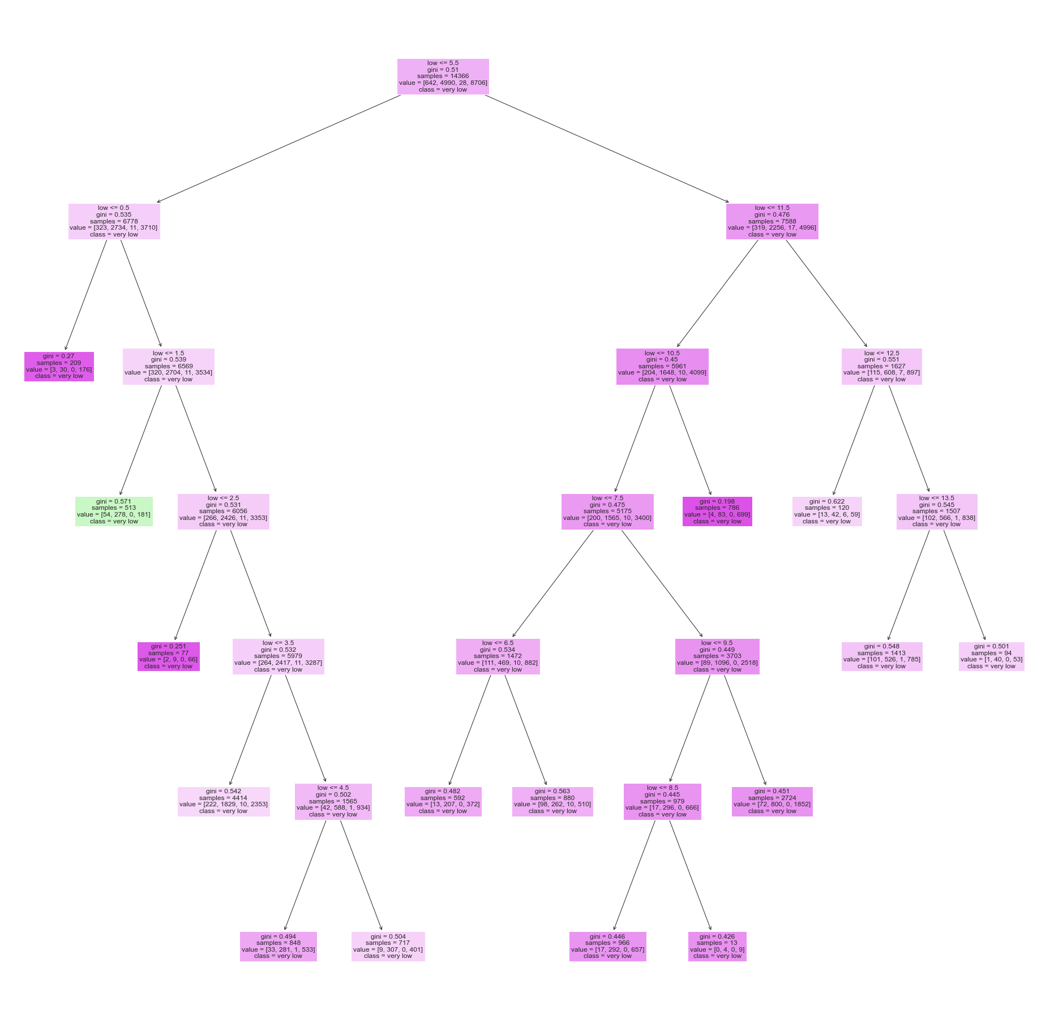

All Countries
Japan
USA

Slide 7
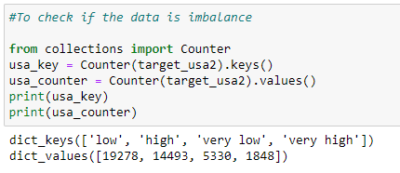

Slide 8
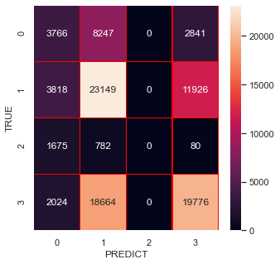
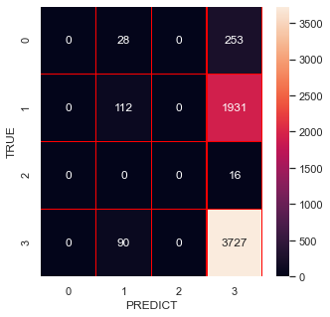
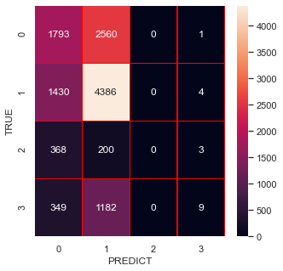
All Countries
Japan
USA

Slide 9
Linear Regression
m= Δ y/ Δ x
Δy = y₂ – y₁
Δx = x₂ – x₁

Slide 10
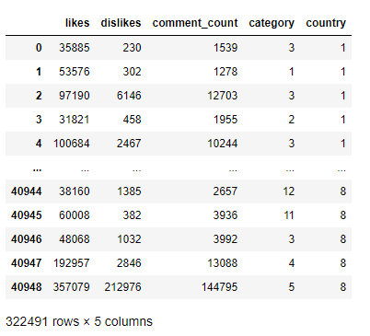
Linear Regression
Classify number of Views into classes
Encode the category and country into number using encoder
Split the data into train and test
Run the test
70% train
30% test
Accuracy = 62.3 %

Slide 11
Discussion
 | Decision Tree | Linear Regression
Result |  | All country accuracy = 62.3 %
Variables | Category only | Category, country, likes, dislikes, comment count
Country | Accuracy | Total Number of Rows
Overall | 48.26% | 322491
USA | 50.37% | 40949
Japan | 62.35% | 20523

